Slide 1
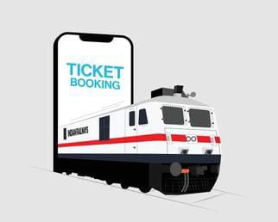
Railway Ticket booking system
DBMS - Project
Notes:
NOTE:
To change the image on this slide, select the picture and delete it. Then click the Pictures icon in the placeholder to insert your own image.

Slide 2
Team:
AP22110010063 - Ramgopal
AP22110010061 - Nagur Meeravali
AP22110010019 - Muzahid
AP22110010062 - Geetesh

Slide 3
Contents
Introduction
Key components of project
ER diagram
Descriptions of topics in the project
Conclusion

Slide 4
Introduction
Project Background:
Railway ticket booking systems are vital for managing reservations efficiently in a railway network. This project aims to develop a robust system that allows users to search for trains, book tickets, and manage reservations online.
Description of the Project:
The Railway Ticket Booking System will provide functionalities for users to:
Search for trains based on various criteria such as source, destination, date, and class.
View available seats and fares for selected trains.
Book tickets by providing passenger details and making payments securely.
Manage bookings, including cancellation and modification of reservations.
Generate e-tickets and receipts for successful bookings

Slide 5
Key components of Project:
Database Structure: The relational database consists of tables representing entities such as users, trains, stations, bookings, tickets, and seats. Each table is designed with appropriate attributes and relationships to capture the essential data elements of the system.
Normalization: The tables are normalized up to the third normal form (3-NF), ensuring data integrity, minimizing redundancy, and preventing anomalies such as insertion, update, and deletion anomalies.
Sample Data: Sample data is inserted into the tables to demonstrate the functionality of the system. This includes information about users, trains, stations, bookings, tickets, and seat availability.
SQL Queries: Several SQL queries are provided to showcase the system's querying capabilities, including retrieving bookings made by a specific user, listing available seats on a train, and retrieving bookings made on a particular date.
Views: Five views are created to offer convenient access to relevant information within the database. These views provide insights into user bookings, available seats, bookings made on the current date, detailed ticket information, and the stations each train passes through.

Slide 6
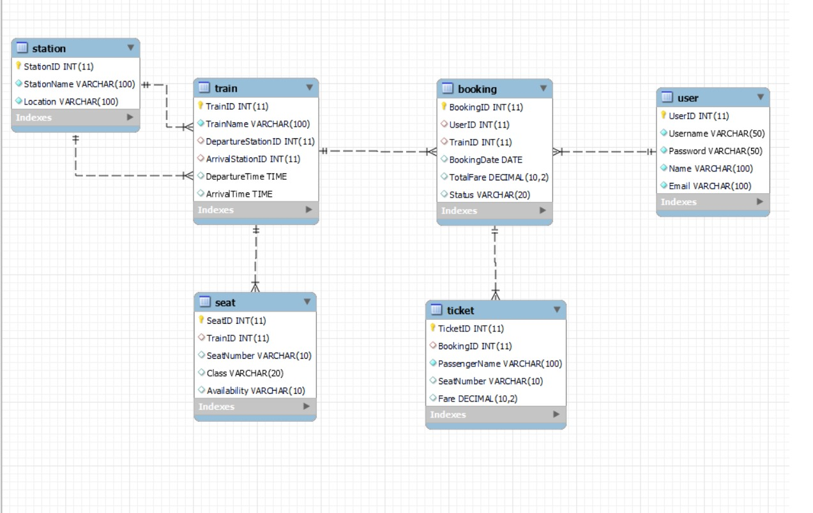
ER Diagram

Slide 7
Descriptions of topics in the project
User Table:
UserID (INT): Primary key uniquely identifying each user.
Username (VARCHAR(50)): Username of the user for login.
Password (VARCHAR(50)): Password of the user for login (stored securely).
Name (VARCHAR(100)): Name of the user.
Email (VARCHAR(100)): Email address of the user
Train Table:
TrainID (INT): Primary key uniquely identifying each train.
TrainName (VARCHAR(100)): Name of the train.
DepartureStationID (INT): Foreign key referencing the StationID of the departure station.
ArrivalStationID (INT): Foreign key referencing the StationID of the arrival station.
DepartureTime (TIME): Departure time of the train.
ArrivalTime (TIME): Arrival time of the train.

Slide 8
Contd…
3. Station Table:
StationID (INT): Primary key uniquely identifying each station.
StationName (VARCHAR(100)): Name of the station.
Location (VARCHAR(100)): Location of the station.
4. Booking Table:
BookingID (INT): Primary key uniquely identifying each booking.
UserID (INT): Foreign key referencing the UserID of the user who made the booking.
TrainID (INT): Foreign key referencing the TrainID of the booked train.
BookingDate (DATE): Date when the booking was made.
TotalFare (DECIMAL(10,2)): Total fare for the booking.
Status (VARCHAR(20))

Slide 9
Contd…
Ticket Table:
TicketID (INT): Primary key uniquely identifying each ticket.
BookingID (INT): Foreign key referencing the BookingID of the booking associated with the ticket.
PassengerName (VARCHAR(100)): Name of the passenger for the ticket.
SeatNumber (VARCHAR(10)): Seat number allocated for the passenger.
Fare (DECIMAL(10,2)): Fare for the ticket.
Seat Table:
SeatID (INT): Primary key uniquely identifying each seat.
TrainID (INT): Foreign key referencing the TrainID of the train associated with the seat.
SeatNumber (VARCHAR(10)): Seat number.
Class (VARCHAR(20)): Class of the seat (e.g., economy, business).
Availability (VARCHAR(10)): Availability status of the seat (e.g., available, booked).

Slide 10
Conclusion
The Railway Ticket Booking System project not only provides a robust database schema but also lays the groundwork for a scalable and user-friendly application. Here's a deeper dive into the significance and implications of this project:
Efficient Data Management: By structuring the database according to the principles of normalization, the system ensures efficient data storage and retrieval. Normalization minimizes data redundancy and inconsistencies, leading to better database performance and reliability.
User-Centric Approach: The system caters to the needs of users by offering functionalities such as searching for trains, booking tickets, managing reservations, and generating e-tickets. The user interface layer built on top of this database infrastructure can enhance user experience further.
Business Insights and Analytics: With a well-organized database in place, railway authorities can extract valuable insights and analytics. They can analyze booking patterns, popular routes, peak travel times, and revenue generation, aiding in strategic decision-making and resource allocation.
Security and Integrity: Security measures, including password hashing, can be implemented to ensure the protection of user data and transactions. Additionally, the normalization process contributes to maintaining data integrity, reducing the risk of anomalies and errors in the system.

Slide 11
THANK YOU

